Slide 1
Weilong (9985.HK) -- IPO Valuation
Have the spicy strips in your memory changed?
Group Members:向宇辰、龙垣桥、李志豪、石泰来、朱奥东、袁钰涛
Jan 8, 2024

Slide 2
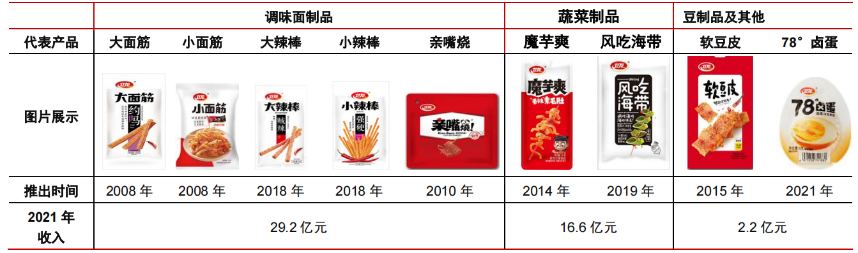
Introduction to Weilong
Main Business
Weilong is a leading spicy snack food company in China. According to Frost&Sullivan, in terms of retail sales value in 2021, it ranked first among all spicy snack food enterprises in China, with a market share of 6.2%, and ranked first in each of the seasoned flour product and spicy vegetable snack product categories. 95.0% of its consumers are at or under the age of 35, and 55.0% are at or under the age of 25.
spicy snack food
(1) Seasoned flour products
(2)Vegetable products
(3)Bean-based products and Braised Egg
Products and Services
Source: CITIC Securities Research Institute, Annual Report of Sansure Biotech
PART Ⅰ: Introduction
Notes:
Weilong ranked first among all spicy snack food enterprises in China, with a market share of 6.2%, and 55.0% are at or under the age of 25. Weilong focus on spicy snack food covering the categories: (1) Seasoned flour products; (2)Vegetable products; (3)Bean-based products and Braised Egg.
魔芋： konjak

Slide 3
Background of the Deal
Items | Information
Method of IPO | Combining targeted placement to strategic investors (strategic allotment), off-line placement to qualified investors by price inquiry (off-line issuance), and online placement to public investors (online distribution)
Period of Subscription | 7 days（2022/12/08-2022/12/14）
Date of IPO | 2022/12/15
Size of IPO | The issuance size was 96.397 million shares, the price per share was HK $10.56, and a total of HK$936 million was raised.
Name of the IPO Firm | WEILONG Delicious Global Holdings Ltd
Name of the Underwriter | Sponsor (Lead Underwriter): Morgan Stanley, CICC, UBS
IPO First-day Return | -5.11%
Cornerstone or Strategic Investors | Sunshine Insurance(阳光人寿), Prospect Bridge
Existing block-holders' lock-up period | 6 months
Disclosed Use of Proceeds
Unit: HK$ Million
No. | Project | Total Investment | Amount of Raised Funds Invested | Construction Subject
1 | Expand and upgrade production facilities and supply chain system | 533.2 | 57.0% | Welong Ltd.
2 | Expand sales and distribution network | 140.3 | 15.0% | Welong Ltd.
3 | Brand building | 93.5 | 10.0% | Welong Ltd.
4 | R&D Upgrade Construction | 93.5 | 10.0% | Welong Ltd..
5 | Advance the digitization and intelligence of our business. | 74.8 | 8.0% | Welong Ltd.
Source: Company Prospectus
PART Ⅰ: Introduction
Notes:
Now let’s take a look at the background of the deal. The date if this IPO was Dec 15, 2022, with the size of 96.397 million shares at HK$ 10.56 per share. The crucial point is the negative IPO first-day return, in other word, stock breaks. Here are the projects in which the raising funds will be used, and we can easily find the main project is to upgrade the supply chain.

Slide 4
The Whole Hong Kong Security Market
Main Business
Hang Seng Index decreases continuously since 2022
The stock break proportion of Hong Kong stocks is extremely high
The decline in the stock price of Weilong may not only be attributed to the company itself but also could be influenced by the overall market conditions in the Hong Kong stock market.

Slide 5
PART Ⅱ: Industry Analysis
The Industry is developing steadily

Slide 6
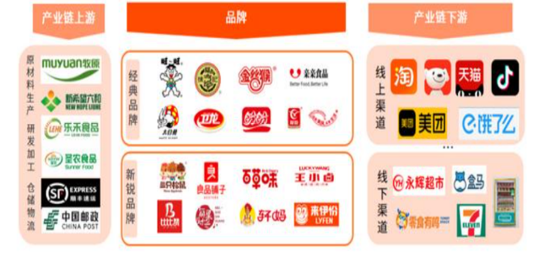
Leisure Food Industry
China: one of the world's largest leisure food markets
Upward trend of development
Growth of residents' disposable income
Acceleration of urbanization.
Increasingly rich consumption scenarios
Emergence of innovative products
Continuous improvement of retail channels
Map of China Leisure Food Industry Chain
Sources: Company Prospectus
PART Ⅲ: Company Analysis
Notes:
Leisure food refers to packaged food that is eaten outside of meals or during leisure time. China is one of the world's largest leisure food markets. Driven by the growth of residents' disposable income, the acceleration of urbanization, increasingly rich consumption scenarios, the emergence of innovative products, and the continuous improvement of retail channels, the leisure food industry has shown an upward trend of development.
休闲食品是指在餐外或休闲时间食用的包装食品。中国是世界上最大的休闲食品市场之一。在居民可支配收入增长、城市化进程加快、消费场景日益丰富、创新产品不断涌现、零售渠道不断完善等因素的推动下，休闲食品行业呈现上升发展趋势。

Slide 7
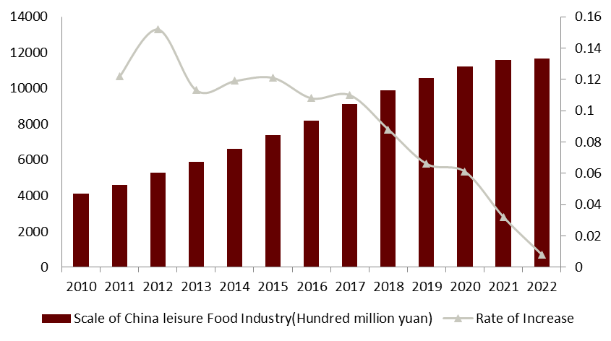
Market Size
China's leisure food industry achieved rapid expansion in recent years and is going to grow steadily
From 2011 to 2022, China’s market achieved compound annual growth rate of 9.96%, and the market size reached 1,165.4 billion yuan in 2022
The increase rate of the whole market decreased since 2017
In 2022, the increase rate is almost 0
Scale of China Leisure food Industry
Sources: Company Prospectus
PART Ⅲ: Company Analysis
Notes:
According to the Frost & Sullivan report, from 2011 to 2018, China's leisure food industry achieved rapid expansion, with a compound annual growth rate of 12.3%, and the market size of the leisure food industry reached 1,029.7 billion yuan in 2018, an increase of 12.0%. From the perspective of the whole change trend of the market size of China's leisure food industry in recent years, China's leisure food industry will show a long-term stable growth trend, by 2021, the national leisure food market size will increase to 1401.5 billion yuan, an increase of 7.9%. From 2015 to 2020, the market size has increased year by year, with a CAGR of 6.6%. China's leisure food market will continue to grow and is expected to reach a compound annual growth rate of 7.3% in 2022-2025.
根据弗若斯特沙利文的报告， 2011-2018年我国休闲食品行业实现快速扩容，年复合增长率达到12.3%，2018年休闲食品行业市场规模达到10297亿元，同比增长12.0%。从近几年我国休闲食品行业市场规模整个变化趋势来看，我国休闲食品行业将呈现出长期稳定增长的态势，到2021年，全国休闲食品市场规模增长至14015亿元，同比增长7.9%。从2015年到2020年，市场规模逐年增长，复合年增长率为6.6%。中国休闲食品市场将持续增长，预计2022-2025年复合年增长率将达到7.3%。

Slide 8
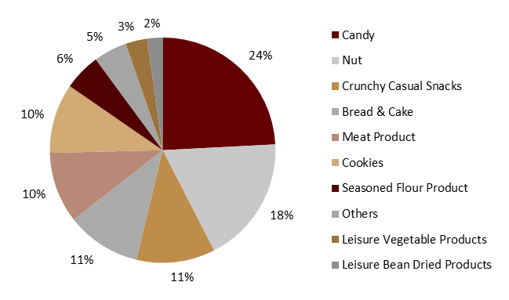
Market Structure
The pattern of leisure food sub-plates is scattered, and the growth rate is different. There are many fine molecule industries in the leisure food competition, and there is certain substitutability among different categories
In 2021, the largest product in China's leisure food market is candy preserves, followed by nuts, with retail sales of 192.2 billion yuan and 104.2 billion yuan, respectively.
Seasoned floured product, leisure vegetable products and leisure bean dried products, main products of Weilong, accounts for 6%, 3% and 2%, which is not that high.
Market size of industry segments in China
Market size of industry segments in China
Sources: Frost&Sullivan
Notes:
The pattern of leisure food sub-plates is scattered, and the growth rate is different. There are many fine molecule industries in the leisure food competition, and there is certain substitutability among different categories, among which each sub-industry is in different industrial cycle stage and growth rate.
In 2020, the largest product in China's leisure food market is candy preserves, followed by bread and pastries, with retail sales of 414.8 billion yuan and 266.3 billion yuan, respectively.
休闲食品分板块格局分散，增长速度参差不齐。休闲食品竞争中的细分子产业众多，不同品类之间存在一定的可替代性，其中各子行业处于不同的产业周期阶段和成长速度。
2020年，中国休闲食品市场最大的产品是糖果蜜饯，其次是面包和糕点，零售额分别为4148亿元和2663亿元。
From the perspective of product categories, the top three categories in the market are candy, chocolate and preserves, seeds and nuts, and crispy leisure foods, accounting for 24.2%, 18.3% and 11.3%, respectively.
从产品品类来看，市场前三大品类分别为糖果、巧克力及蜜饯、种子及坚果、酥脆休闲食品，占比分别为24.2%、18.3%和11.3%。
China's leisure food industry presents a vigorous development trend, product categories continue to expand, the market competition is becoming increasingly fierce. According to industry data, the top three leading categories in the current market are confectionery, chocolate and preserves, roasted seeds and nuts, and crispy leisure foods. Among them, candy, with its unique taste and diverse tastes, has successfully occupied a market share of 24.2%, ranking first in the entire leisure food market. Followed by chocolate and preserves, with strong chocolate flavor and creative preserves products, accounting for 18.3% of the market share, continuing to maintain a strong competitive situation.
中国休闲食品行业呈现出蓬勃发展的趋势，产品种类不断扩大，市场竞争日趋激烈。据行业数据显示，目前市场上排名前三的主要类别是糖果、巧克力和蜜饯、烤种子和坚果、脆皮休闲食品。其中，糖果以其独特的口感和多样的口味，成功占据了24.2%的市场份额，在整个休闲食品市场中排名第一。其次是巧克力和蜜饯，以浓郁的巧克力风味和创意蜜饯产品，占18.3%的市场份额，继续保持强劲的竞争态势。
At the same time, seeds and nuts roasted and crispy leisure foods also ushered in rapid growth, accounting for 11.3% of the market. These two emerging categories, with their natural, healthy and portable characteristics, have gradually become the choice of consumers' healthy lifestyle. With the improvement of living standards and the upgrading of consumption concepts, the leisure food industry will further accelerate product innovation and category expansion, and provide consumers with more diversified leisure food choices that meet the needs of personalized tastes.
与此同时，种子坚果烤脆休闲食品也迎来快速增长，市场占比达到11.3%。这两个新兴品类以其天然、健康、便携的特点，逐渐成为消费者健康生活方式的选择。随着生活水平的提高和消费观念的升级，休闲食品行业将进一步加快产品创新和品类扩张，为消费者提供更多元化的休闲食品选择，满足个性化口味的需求。

Slide 9
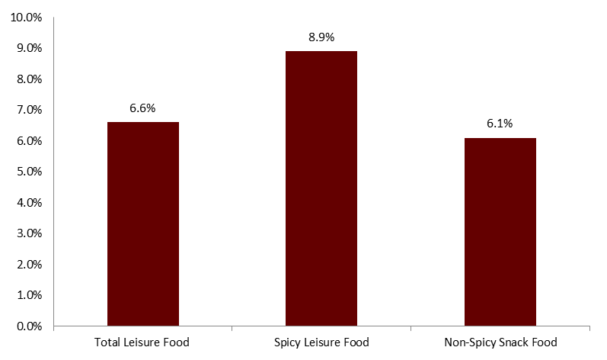
Taste: Spicy or Non-Spicy
Spicy leisure food market grows faster than non-spicy food
Retail Sales & Growth Rate
The retail sales of China's spicy leisure food industry increased from 102.6 billion yuan in 2015 to 157 billion yuan in 2020, with a compound annual growth rate of 8.9%.
The share of China's spicy leisure food in the overall leisure food industry increased from 18.3% in 2015 to 20.3% in 2020.
2020 Growth Rate of Leisure Food Industry by Taste
Retail Sales by Taste in China's Leisure Food Industry
Sources: Website
PART Ⅲ: Company Analysis
Notes:
According to the Frost & Sullivan report, leisure food can also be divided into spicy leisure food and non-spicy leisure food according to taste. Spicy leisure food refers to the leisure food containing one or more spicy spices; Non-spicy leisure food refers to the leisure food that does not contain spicy spices in the raw materials. The following table shows the breakdown of retail sales by taste in China's leisure food industry from 2015 to 2020:
根据Frost & Sullivan的报告，休闲食品按口味也可分为辛辣休闲食品和非辛辣休闲食品。辛辣休闲食品是指含有一种或者多种辛辣香料的休闲食品;非辛辣休闲食品是指原料中不含辛辣香料的休闲食品。下表为2015 - 2020年中国休闲食品行业按口味零售情况:
Spicy leisure foods are gaining popularity among Chinese consumers. With the continuous innovation in the field of spicy leisure food in recent years, many food manufacturers continue to develop new spicy leisure food to adapt to changing consumer preferences, which has promoted the growth of the spicy leisure food industry. The retail sales of China's spicy leisure food industry increased from 102.6 billion yuan in 2015 to 157 billion yuan in 2020, with a compound annual growth rate of 8.9%, higher than the compound annual growth rate of the leisure food industry in the same period. The share of China's spicy leisure food in the overall leisure food industry increased from 18.3% in 2015 to 20.3% in 2020. According to the Frost & Sullivan Report, China's spicy leisure food industry is expected to grow at a compound annual growth rate of 10.4% from 2020 to 2025, and retail sales will reach 257 billion yuan by 2025, while China's non-spicy leisure food industry is expected to grow at a compound annual growth rate of 6.4% over the same period.
辛辣休闲食品在中国消费者中越来越受欢迎。随着近年来麻辣休闲食品领域的不断创新，许多食品生产企业不断开发新的麻辣休闲食品，以适应不断变化的消费者偏好，从而促进了麻辣休闲食品行业的增长。中国麻辣休闲食品行业零售额从2015年的1026亿元增加到2020年的1570亿元，复合年增长率为8.9%，高于同期休闲食品行业的复合年增长率。在零售额方面，中国麻辣休闲食品占整个休闲食品行业的比重从2015年的18.3%上升到2020年的20.3%。根据弗若斯特沙利文报告，2020年至2025年，中国麻辣休闲食品行业预计将以10.4%的复合年增长率增长，到2025年，零售额将达到2570亿元人民币，而同期中国非麻辣休闲食品行业预计将以6.4%的复合年增长率增长。

Slide 10
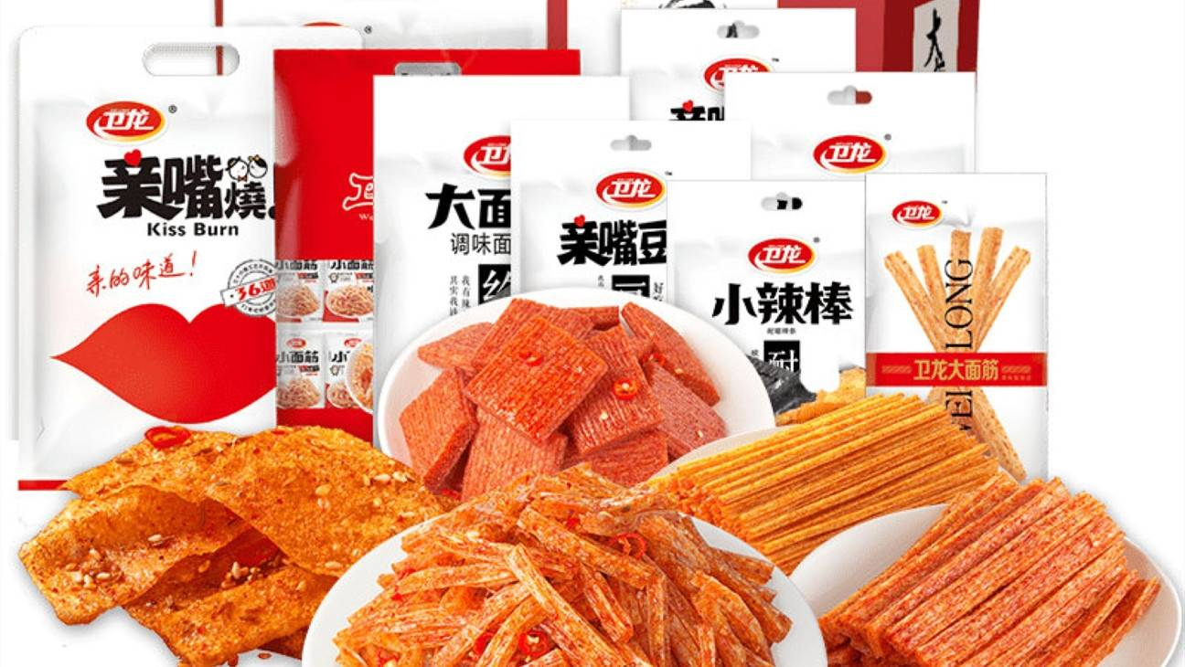
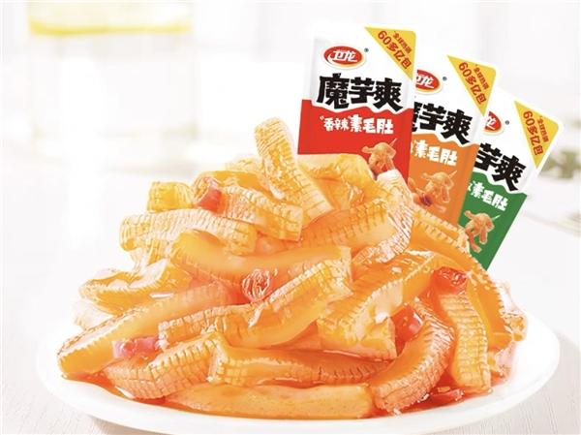
Driving Factor & Development Trend
Economic growth and rising per capita disposable income will significantly enhance consumer purchasing power, thereby driving the growth of the spicy leisure food market.
Growing consumer base. The adaptability and addictiveness of spicy flavors are intriguing. Many individuals develop a tolerance, seeking progressively spicier options. The sensation triggers the release of endorphins, creating a pleasurable experience and contributing to the potential addictive nature of spicy foods.
Continuous product innovation and upgrading. China's leading spicy leisure food producers continue to introduce new flavors, and spicy leisure food has developed a variety of spicy flavors, including sweet and hot, sour and hot, to meet a wider range of consumer needs.
PART Ⅲ: Company Analysis
Notes:
Continued growth in the economy and disposable income. China's per capita disposable annual income has increased to 322 yuan in 2020 and is expected to further increase to 46.8 thousand yuan in 2025. Economic growth and rising per capita disposable income will significantly enhance consumer purchasing power, thereby driving the growth of the spicy leisure food market.
经济和居民可支配收入持续增长。到2020年，中国的人均可支配收入已经增加到322元，预计到2025年将进一步增加到4.68万元。经济的增长和人均可支配收入的提高将显著提高消费者的购买力，从而带动麻辣休闲食品市场的增长。
Growing consumer base. Spicy leisure food can bring consumers a pleasant consumption experience, so that consumers feel happy, satisfied and comforted, so spicy leisure food is favored by consumers from different ages, and has cultivated a growing consumer group of spicy leisure food. The rise of the Internet, e-commerce and social media in China has helped boost the popularity of spicy leisure foods. For example, more and more Internet celebrities regard spicy leisure food as an interesting material for their content creation and carry out the big stomach king challenge on well-known social platforms, which further accelerates the mass communication of spicy leisure food.
不断增长的消费者基础。麻辣休闲食品可以给消费者带来愉快的消费体验，让消费者感到快乐、满足和安慰，因此麻辣休闲食品受到不同年龄层消费者的青睐，已经培养出越来越多的麻辣休闲食品消费群体。互联网、电子商务和社交媒体在中国的兴起，推动了辛辣休闲食品的普及。例如，越来越多的网红将辛辣休闲食品作为内容创作的有趣素材，在知名社交平台开展大胃王挑战，进一步加速了辛辣休闲食品的大众传播。
Continuous product innovation and upgrading. China's leading spicy leisure food producers continue to introduce new flavors, and spicy leisure food has developed a variety of spicy flavors, including sweet and hot, sour and hot, to meet a wider range of consumer needs. In addition, there are a number of potential market segments in the spicy leisure food industry, such as kelp, magic Qian and other spicy leisure vegetable products. Thanks to their healthy product properties, excellent taste and continuous product innovation, these products have generated great appeal to consumers. Konjac products, for example, have high dietary fiber, low carbohydrate, low fat health properties, so it is widely popular. According to the Frost & Sullivan report, in 2020, China's per capita annual consumption of magic Qian is less than 0.1 kg, while Japan's per capita annual consumption is about 2.0 kg, showing that magic Qian products still have huge growth potential in China.
产品不断创新升级。中国领先的麻辣休闲食品生产商不断推出新口味，麻辣休闲食品开发出甜辣、酸辣等多种麻辣口味，以满足更广泛的消费者需求。此外，麻辣休闲食品行业还有一些潜在的细分市场，如海带、魔钱等麻辣休闲蔬菜产品。这些产品以其健康的产品特性、卓越的口感和不断的产品创新，对消费者产生了巨大的吸引力。以魔芋制品为例，它具有高膳食纤维、低碳水化合物、低脂肪的保健特性，因此广受欢迎。根据弗若斯特沙利文的报告，到2020年，中国人均年消费魔钱不到0.1公斤，而日本人均年消费约为2.0公斤，可见魔钱产品在中国仍有巨大的增长潜力。

Slide 11
PART Ⅲ: Company Analysis
New business strategy but hasty listing timing

Slide 12
Hurry Listing on the Hong Kong Stock Exchange
Two failed listings——May, 2021 and Nov, 2021
Huge share compensation
Wei Long sold 157.6 million shares of common stock to investors at a price of $0.00001 per share, almost free of charge, and transferred the shares to previous investors.
This move also significantly lowered the company’s stock price
Hurry listing
We guess that Weilong is eager to go public to avoid default penalties due to signing a VAM(valuation adjustment mechanism,对赌协议) with investment institutions.
In December 2022, Wei Long (09985. HK) was listed on the Hong Kong Stock Exchange.
Sources: Company Prospectus
PART Ⅲ: Company Analysis
Notes:
Weilong listed on the Hong Kong Stock Exchange in a hurry
In May and November 2021, Weilong failed to go public twice. In April 2022, institutional investors such as Hillhouse, Sequoia, Tencent, and CPE Yuanfeng demanded huge share compensation from Weilong. Wei Long sold 157.6 million shares of common stock to investors at a price of $0.00001 per share, almost free of charge, and transferred the shares to previous investors. This move also significantly lowered the company's profits, resulting in a direct loss of over 200 million yuan in the first half of the year. Due to signing a betting agreement with investment institutions, Weilong is eager to go public to avoid default penalties. In December 2022, Weilong (09985. HK) was listed on the Hong Kong Stock Exchange.
一波三折，仓促上市：2021年5月和11月，卫龙分别两次上市失败。2022年4月，高瓴、红杉、腾讯、CPE源峰等机构投资人，要求卫龙进行了巨额的股份补偿。卫龙以0.00001美元每股的价格向投资者出售了1.576亿股普通股，近乎无偿地将股份转给了前期投资者。此举还大幅拉低了公司利润，导致公司上半年直接亏损了2个多亿。由于和投资机构签署了对赌协议，卫龙急于上市以规避违约惩罚。2022年12月，卫龙（09985.HK）在港交所上市。

Slide 13
Competition + Epidemic → Decline in Performance
In 2022H1, the company's revenue and net profit have significantly declined
Main product of the seasoning noodle business: High gross profit margin + low technical complexity → attract numerous competitors
The epidemic has affected production and delivery. Meanwhile, students rarely consume spicy snacks during online classes at home.
Revenue and YoY
Net Income and YoY
Sources: Company Prospectus
PART Ⅲ: Company Analysis
Notes:
Performance declined in recent years due to fierce competition and repeated epidemic
From 2019 to 2021, although revenue was increasing, its net profit increased by 38.18%, 24.41%, and 0.97% year-on-year, respectively; In the first half of 2022, Weilong achieved a revenue of approximately 2.261 billion yuan, a decrease of 1.8% compared to the same period last year. The profit turned from profit to loss, with a loss of 261 million yuan. However, for the full year of 2021, the profit was 827 million yuan. The company's revenue and net income have significantly declined, and product sales are facing difficulties. The company's main seasoning noodle products have the characteristics of high gross profit margin and low technical content. Therefore, this type of business is favored by many competitors. Three squirrels launched the spicy noodle category in 2015 and established a separate spicy noodle key project team in 2018; Yanjin Puzi established a spicy noodle product research and development center in 2017 and set the goal of becoming the second in China's spicy noodle industry. Under these competitions, Weilong's sales in the first half of 2022 decreased by 13.82% year-on-year. In addition, the repeated outbreaks of the epidemic have had a certain impact on the company's production and delivery. The epidemic has caused students to take online classes at home, which has also reduced their consumption of spicy snacks.
竞争激烈+疫情反复，业绩下滑：2019年至2021年，虽然营收正在增长，但其净利润分别同比增长38.18%、24.41%和0.97%；2022年上半年卫龙实现营收约22.61亿元，较上年同期下降1.8%，利润由盈转亏，亏损达2.61亿元，而2021年全年则盈利8.27亿元。公司营收净利大幅下滑，产品出现了“卖不动”的现象。公司主营产品辣条所在的调味面制品业务具有毛利率高、技术含量低的特点。因此这类业务受到很多竞争对手的青睐。三只松鼠在2015年上线了辣条品类，2018年单独开辟辣条重点项目组；盐津铺子在2017年成立了辣条产品研发中心，并立下了中国“辣条行业第二”的目标。在这些竞争下，卫龙2022上半年的销量同比下降13.82%。除此之外，疫情反复对公司的生产和交付产生了一定影响。疫情导致的学生在家上网课，也降低了学生群体对辣味零食的消费。

Slide 14
Distributed Market Structure of Major Products
Spicy snack food CR5(2021)
The company has the highest market share in the spicy snack food industry, with a share 3.9 times that of the second place, exceeding the combined market share of the second to fifth places.
People's consumption stickiness towards snack food is not high, and it is difficult to stick to a certain brand.
Market distribution of spicy snack food(2021)
?
How important is it to retain customers in a dispersed market and low customer stickiness
Sources: Frost&Sullivan
PART Ⅲ: Company Analysis
Notes:
The market structure of the main products is scattered
The company has the highest market share in the spicy snack food industry, at 6.2%, which is 3.9 times the market share of the second place, exceeding the sum of market shares from the second to fifth places, indicating a dispersed industry landscape. People's consumption stickiness towards snack food is not high, and it is difficult to stick to a certain brand. They may purchase it based on cost-effectiveness, taste, or even mood.
主营产品市场格局分散：公司在辣味休闲食品行业的市占率最高，为6.2%，份额是第2名的3.9倍，超过了第2至第5名市场份额之和，这说明行业格局分散。人们对休闲食品的消费黏性并不大，很难成为某个品牌的“铁粉”，而很可能根据性价比、看口味甚至是心情购买。

Slide 15
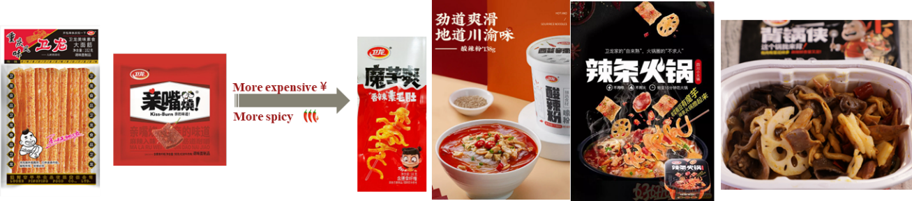
Customer Acquisition Strategy
Intergenerational changes in customers
acquisition of new customers
Since 2014, Weilong has embarked on a path of leisure transformation and has launched new products.
New products: Actively developing new products, but the acceptance of the products remains to be verified.
Product category expansion
Sources: Website
PART Ⅲ: Company Analysis
Notes:
Mistakes in customer acquisition strategy
95% of the company's consumers are under 35 years old, and 55% of consumers are under 25 years old, making it the top snack food brand among young people under 25 years old. As the main customers grow older, the company neglects to acquire younger customers. Since 2014, Weilong has started the road of transformation. It has successively launched konjac, crisp noodles, self heating hot pot "Backing Pot Man", hot and sour noodles, "self cooked" spicy hot pot and other products. These new products have almost abandoned elementary school students. On the one hand, its new product is priced higher than spicy strips, and on the other hand, the spiciness makes it difficult for elementary school students to accept.
获客战略失误：公司95%的消费者年龄低于35岁，55%的消费者低于25岁，是25岁以下青年群体中的休闲食品第一品牌。随着主要客户群体的逐渐长大，公司忽视对更年轻客户的获取。2014年起，卫龙开始休闲化转型之路，先后推出魔芋、干脆面、自热火锅“背锅侠”、酸辣粉、“自来熟”辣条火锅等产品。这些新品几乎已经抛弃了小学生。一方面是其新品定价比辣条更高，一方面是辣度让小学生难以接受。

Slide 16
PART Ⅳ: Valuation
Fundamental Valuation & Relative Valuation
Notes:
To evaluate this company quantitatively, we adopt both the fundamental and relative valuation. As for the absolute valuation, we use the DCF method.

Slide 17
DCF: Calculation of WACC
Comparable Firms | 恰恰食品 | 桃李面包 | 良品铺子 | 盐津铺子 | 三只松鼠 | 甘源食品
Levered Beta | 0.92 | 1.16 | 0.95 | 0.63 | 1.18 | 1.11
D/E ratio | 0.06 | 0.03 | 0.03 | 0.04 | 0.05 | 0
Tax Rate | 24% | 24% | 24% | 24% | 24% | 24%
Unlevered Beta | 0.88 | 1.13 | 0.93 | 0.61 | 1.14 | 1.11
Industry Beta | 0.96
Industry Beta | 0.96
D/E ratio | 0.04
Tax rate | 24%
Beta | 0.99
Risk free rate | 2.86%
Risk premium | 4.7%
Cost of Equity | 7.51%
Cost of Debt | 2.54%
WACC | 7.37%
Explanations of data resources
Comparable firms: Enterprises boasting comparable market shares within the snack sector
Levered Beta: daily rate of return of the firms and CSI 300, at the period of 2022/6/16 to 2022/12/15
Risk free rate: the rate of 10-years government bond
Risk premium: correlation of company’s daily rate of return and CSI 300, past ten years
Cost of debt: combination of short-term debt and long-term debt
Calculation was done in Wind

Slide 18
DCF: Prediction of Revenue
(In thoudsand RMB) | 2019A | 2020A | 2021A | 2022A | AVG RATE | 2023E | 2024E | 2025E | 2026E
Revenue | 3384,766 | 4120357 | 4800200 | 4632,221 |  | 5139780 | 5713698 | 6363687 | 7100982
Seasoned flour products | 2,474,574 | 2,690,287 | 2,918,039 | 2,718,613 |  | 2,936,102 | 3,170,990 | 3,424,669 | 3,698,643
yoy |  | 8.72% | 8.47% | -6.83% | 3.45% | 8% | 8% | 8% | 8%
Vegetable products | 664,959 | 1,167,541 | 1,664,120 | 1,693,339 |  | 1,981,207 | 2,318,012 | 2,712,074 | 3,173,126
yoy |  | 75.58% | 42.53% | 1.76% | 39.96% | 17% | 17% | 17% | 17%
Bean-based and other products | 245,233 | 262,529 | 218,041 | 220,269 |  | 222,472 | 224,696 | 226,943 | 229,213
yoy |  | 7.05% | -16.95% | 1.02% | -2.96% | 1% | 1% | 1% | 1%
 | 2019A | 2020A | 2021A | 2022A | Avg rate | 2023E | 2024E | 2025E | 2026E
Gross Profit
Seasoned flour products | 2,474,574 | 2,690,287 | 2,918,039 | 2,718,613 |  | 2,936,102 | 3,170,990 | 3,424,669 | 3,698,643
yoy |  | 10.02% | 3.44% | 3.58% | 5.68% | 5.00% | 5.00% | 5.00% | 5.00%
Vegetable products | 664,959 | 1,167,541 | 1,664,120 | 1,693,339 |  | 1,981,207 | 2,318,012 | 2,712,074 | 3,173,126
yoy |  | 85.12% | 44.75% | 19.56% | 49.81% | 20.00% | 20.00% | 20.00% | 50.00%
Bean-based and other products | 245,233 | 262,529 | 218,041 | 220,269 |  | 222,472 | 224,696 | 226,943 | 229,213
yoy |  | 9.78% | -13.17% | -0.83% | -1.40% | 0.00% | 1.00% | 1.00% | 1.00%
Total Cost | 2,130,463 | 2,554,692 | 3,007,169 | 2,672,616 |  | 2,967,317 | 3,293,119 | 3,654,064 | 3,642,448
YoY of gross profit
Cost = revenue - gross profit
Notes:
The second part is prediction of revenue. The revenue of Weilong can be divided into three parts, and we predict the divisional revenue respectively.
算出 revenue, net profit和cost

Slide 19
DCF: Prediction of Cost and NWC
NWC = (A/R + Inv. + other current asset) – (A/P + other current liability)
A/R = revenue/ turnover ratio
A/P, Inventory = cost/ turnover ratio
Others = % of revenue
 | 2019A | 2020A | 2021A | 2022A | Avg rate | 2023E | 2024E | 2025E | 2026E
NWC | 210,100 | 530,380 | 1,236,478 | 836,810 |  | 827,505 | 919,905 | 1,024,554 | 1,143,258
%Revenue | 6.21% | 12.87% | 25.76% | 18.06% |  | 16.26% | 16.27% | 16.27% | 16.29%
ΔNWC |  | 320,280 | 706,098 | -399,668 |  | -9,305 | 92,401 | 104,648 | 118,705
Non-cash CA | 996,879 | 1,698,331 | 2,491,990 | 2,242,733 |  | 2,266,643 | 2,519,741 | 2,806,386 | 3,131,533
A/R | 28,320 | 46,657 | 69,884 | 128,834 |  | 77,097 | 85,705 | 95,455 | 106,515
1 / A/R Turnover ratio | 0.84% | 1.13% | 1.46% | 2.78% | 1.55% | 1.50% | 1.50% | 1.50% | 1.50%
Inventory | 399,930 | 541,026 | 604,255 | 599,263 |  | 647,612 | 719,926 | 801,825 | 894,724
1 / Inv. Turnover ratio | 11.82% | 13.13% | 12.59% | 12.94% | 12.62% | 12.60% | 12.60% | 12.60% | 12.60%
Others-noncash | 568,629 | 1,110,648 | 1,817,851 | 1,514,636 |  | 1,541,934 | 1,714,110 | 1,909,106 | 2,130,295
%Revenue | 16.80% | 26.96% | 37.87% | 32.70% | 28.58% | 30.00% | 30.00% | 30.00% | 30.00%
Current Liability | 786,779 | 1,167,951 | 1,255,512 | 1,405,923 |  | 1,439,139 | 1,599,836 | 1,781,832 | 1,988,275
A/P | 401,388 | 462,114 | 593,855 | 689,732 |  | 668,171 | 742,781 | 827,279 | 923,128
1 / A/P Turnover ratio | 11.86% | 11.22% | 12.37% | 14.89% | 12.58% | 13.00% | 13.00% | 13.00% | 13.00%
Others-CL | 385,391 | 705,837 | 661,657 | 716,191 |  | 770,967 | 857,055 | 954,553 | 1,065,147
%Revenue | 11.39% | 17.13% | 13.78% | 15.46% | 14.44% | 15.00% | 15.00% | 15.00% | 15.00%
Notes:
For the part of cost, we mainly predict the yoy of gross margin, and basically use it to calculate cost. As for the net working capital, we predict the turnover ratio. For time reason, let look at the FCF directly.
再算NWC

Slide 20
DCF: Calculation of NPV and Price
 | 2019A | 2020A | 2021A | 2022A | Avg rate | 2023E | 2024E | 2025E | 2026E
Revenue | 3,384,766 | 4,120,357 | 4,800,200 | 4,632,221 |  | 5,139,780 | 5,713,698 | 6,363,687 | 7,100,982
yoy |  | 21.73% | 16.50% | -3.50% |  | 10.96% | 11.17% | 11.38% | 11.59%
cost | 2,130,463 | 2,554,692 | 3,007,169 | 2,672,616 |  | 2,967,317 | 3,293,119 | 3,654,064 | 3,642,448
%Revenue | 62.94% | 62.00% | 62.65% | 57.70% |  | 57.73% | 57.64% | 57.42% | 51.29%
yoy | 19.91% | 17.71% | -11.13%
SG&A | 367,339 | 506,551 | 773,287 | 1,116,987 |  | 770,967 | 857,055 | 954,553 | 1,065,147
%Revenue | 10.85% | 12.29% | 16.11% | 24.11% | 15.84% | 15.00% | 15.00% | 15.00% | 15.00%
D&A | 52,130 | 65,520 | 106,436 | 135,267 |  | 102,796 | 114,274 | 127,274 | 142,020
%Revenue | 1.54% | 1.59% | 2.22% | 2.92% | 2.07% | 2% | 2% | 2% | 2%
Government compension and others | 35,148 | 58,841 | 152,666 | 107,578 |  | 102,796 | 114,274 | 127,274 | 142,020
%Revenue | 1.04% | 1.43% | 3.18% | 2.32% | 1.99% | 2% | 2% | 2% | 2%
Other operating expenses | 1,744 | -30,827 | -11,412 | 460,237
Operating Profit | 868,238 | 1,083,262 | 1,077,386 | 354,692 |  | 1,195,905 | 1,334,976 | 1,500,522 | 2,109,348
Other expense | 1,730 | 4,925 | -19,246 | -57,685
EBIT | 866,508 | 1,078,337 | 1,096,632 | 412,377 |  | 1,195,905 | 1,334,976 | 1,500,522 | 2,109,348
Tax | 208,409 | 259,573 | 269,903 | 261,080 |  | 288,213 | 321,729 | 361,626 | 508,353
NI | 658,099 | 818,764 | 826,729 | 151,297 |  | 907,692 | 1,013,247 | 1,138,896 | 1,600,995
Others | 2,638 | -19,667 | -23,112 | 147,692
D&A | 52,130 | 65,520 | 106,436 | 135,267 |  | 102,796 | 114,274 | 127,274 | 142,020
ΔNWC |  | 320,280 | 706,098 | -399,668 |  | -9,305 | 92,401 | 104,648 | 118,705
Capex | 190,600 | 336,500 | 377,300 | 288,482 |  | 359,785 | 399,959 | 445,458 | 497,069
%Revenue | 5.63% | 8.17% | 7.86% | 6.23% | 6.97% | 7.00% | 7.00% | 7.00% | 7.00%
FCF |  | 207,837 | -173,345 | 545,442 |  | 660,008 | 814,171 | 915,438 | 1,349,715
Top-bottom approach
FCF = EBIT – Tax + D&A – change in NWC – capital expenditure
SG&A, D&A, capex predicted by percentage of revenue
Price = firm value / paid-in capital (2022-12-31)
V =20,639,168 thousand yuan
Price = 6.40 yuan

Slide 21
DCF: Sensitivity Analysis
 |  | WACC
 |  | 5% | 6% | 7.37% | 8% | 9%
growth rate of Seasoned flour products | 0% | 11.68 | 9.52 | 7.72 | 7.03 | 6.25
 | 5% | 10.49 | 8.55 | 6.93 | 6.32 | 5.62
 | 8% | 9.68 | 7.89 | 6.40 | 5.83 | 5.18
 | 15% | 7.46 | 6.09 | 4.94 | 4.51 | 4.01
 | 20% | 5.58 | 4.56 | 3.71 | 3.39 | 3.02
 |  | WACC
 |  | 5% | 6% | 7.37% | 8% | 9%
growth rate of Vegetable products | 10% | 11.14 | 9.08 | 7.36 | 6.71 | 5.96
 | 15% | 10.12 | 8.25 | 6.69 | 6.10 | 5.42
 | 17% | 9.68 | 7.89 | 6.40 | 5.83 | 5.18
 | 25% | 7.61 | 6.21 | 5.04 | 4.60 | 4.09
 | 30% | 6.07 | 4.96 | 4.04 | 3.69 | 3.28

Slide 22
Seven Comparable Companies
Code | Company | Revenue | Stock Price | Market Value | P/E (2021) | P/E (2022E) | P/E (2023E)
002557.SZ | 洽洽食品 | 688.34 | 50.44 | 255.73 | 33.5 | 25.97 | 20.94
603866.SH | 桃李面包 | 668.63 | 13.16 | 175.42 | 35.43 | 32.07 | 18.39
002991.SZ | 甘源食品 | 145.07 | 73.48 | 68.5 | 46.29 | 44.92 | 22.09
002847.SZ | 盐津铺子 | 289.35 | 68.79 | 134.87 | 73.46 | 46.22 | 25.02
300783.SZ | 三只松鼠 | 729.32 | 22.94 | 91.99 | 38.01 | 66.71 | 32.35
603719.SH | 良品铺子 | 943.96 | 37.46 | 150.21 | 60.49 | 44.07 | 23.59
1458.HK | 周黑鸭 | 235.72 | 5.02 | 119.64 | 33.46 | 473.19 | 21.26
Average P/E |  |  |  |  |  | 104.74 | 23.38

Slide 23
P/E Valuation Method
 | 2021(A) | 2022)(E) | 2023(E)
Net Income | 83 | 15 | 91
Shares outstanding | 225 | 225 | 225
EPS | 0.37 | 0.07 | 0.4
PE | - | 146.63 | 21.254
Price |  | 7.33 | 9.35
PART Ⅳ: Valuation

Slide 24
Valuation Result and Closing Price
DCF Method Price = ¥ 6.40
P/E Method Price = ¥ 7.33
Target Price = ¥ 6.865, Listing Price = ¥ 8.9347.
Average Price = ¥ 7.7678
Price at 2024/01/05 = ¥ 5.9697
23.2% Downside
PART Ⅳ: Valuation
Notes:
According to two valuation method, we get the average target price ¥ 6.865, which has about 23.2% downside. So we believe IPO price of Weilong is overvalued.

Slide 25

Summary
The timing of the company's listing is not wise
The sustained growth of the company's old products is uncertain
the acceptance of new products awaits market validation.
The overall Hong Kong stock market is sluggish
The company's hurried IPO to evade penalties related to gambling agreements was inappropriate, directly causing a stock price decline.
PART Ⅲ: Company Analysis
Notes:
In conclusion, we believe that the timing of the company's listing is not wise. Firstly, Weilong's performance is based on its high gross profit margin in seasoning noodle products, and this business is being impacted by a large number of competitors; Secondly, the mistakes in the company's customer acquisition strategy make it difficult for people to form their expectations for future growth. Based on the above analysis, the company's hasty decision to go public in order to avoid punishment for gambling agreements was not appropriate, which directly led to a decline in stock prices.
总之，我们认为该公司的上市时机并不明智。首先，卫龙的业绩是基于其调味面制品的高毛利，而这块业务正受到大量竞争对手的冲击；第二，公司获客策略的失误使人们难以形成其未来增长的预期。通过以上分析，公司为了避免对赌协议惩罚而仓促选择的上市时机并不恰当，这直接导致了股价的跌落。

